Slide 1
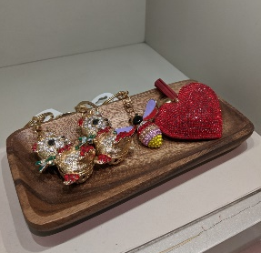
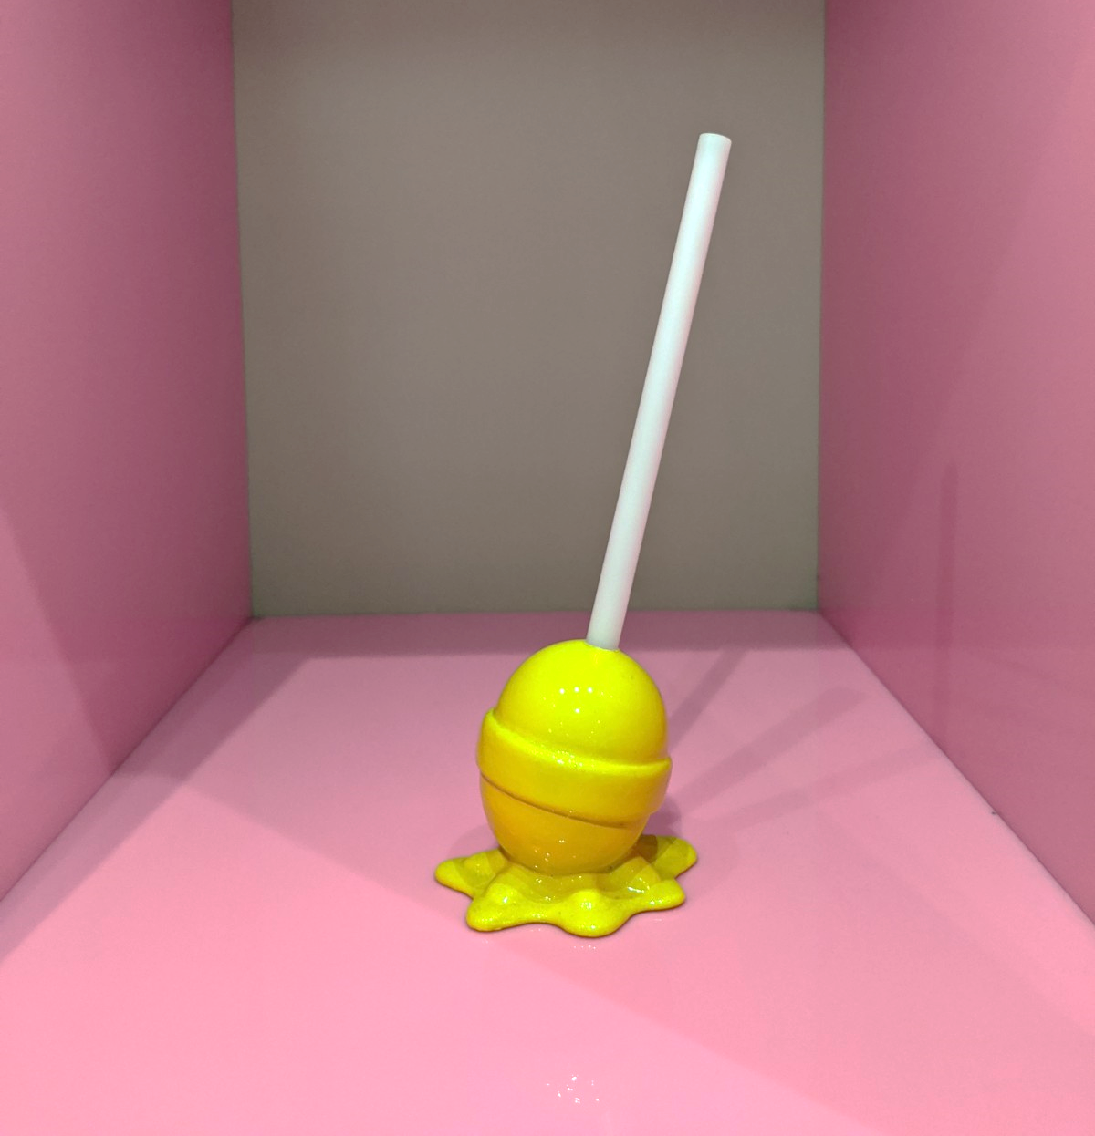
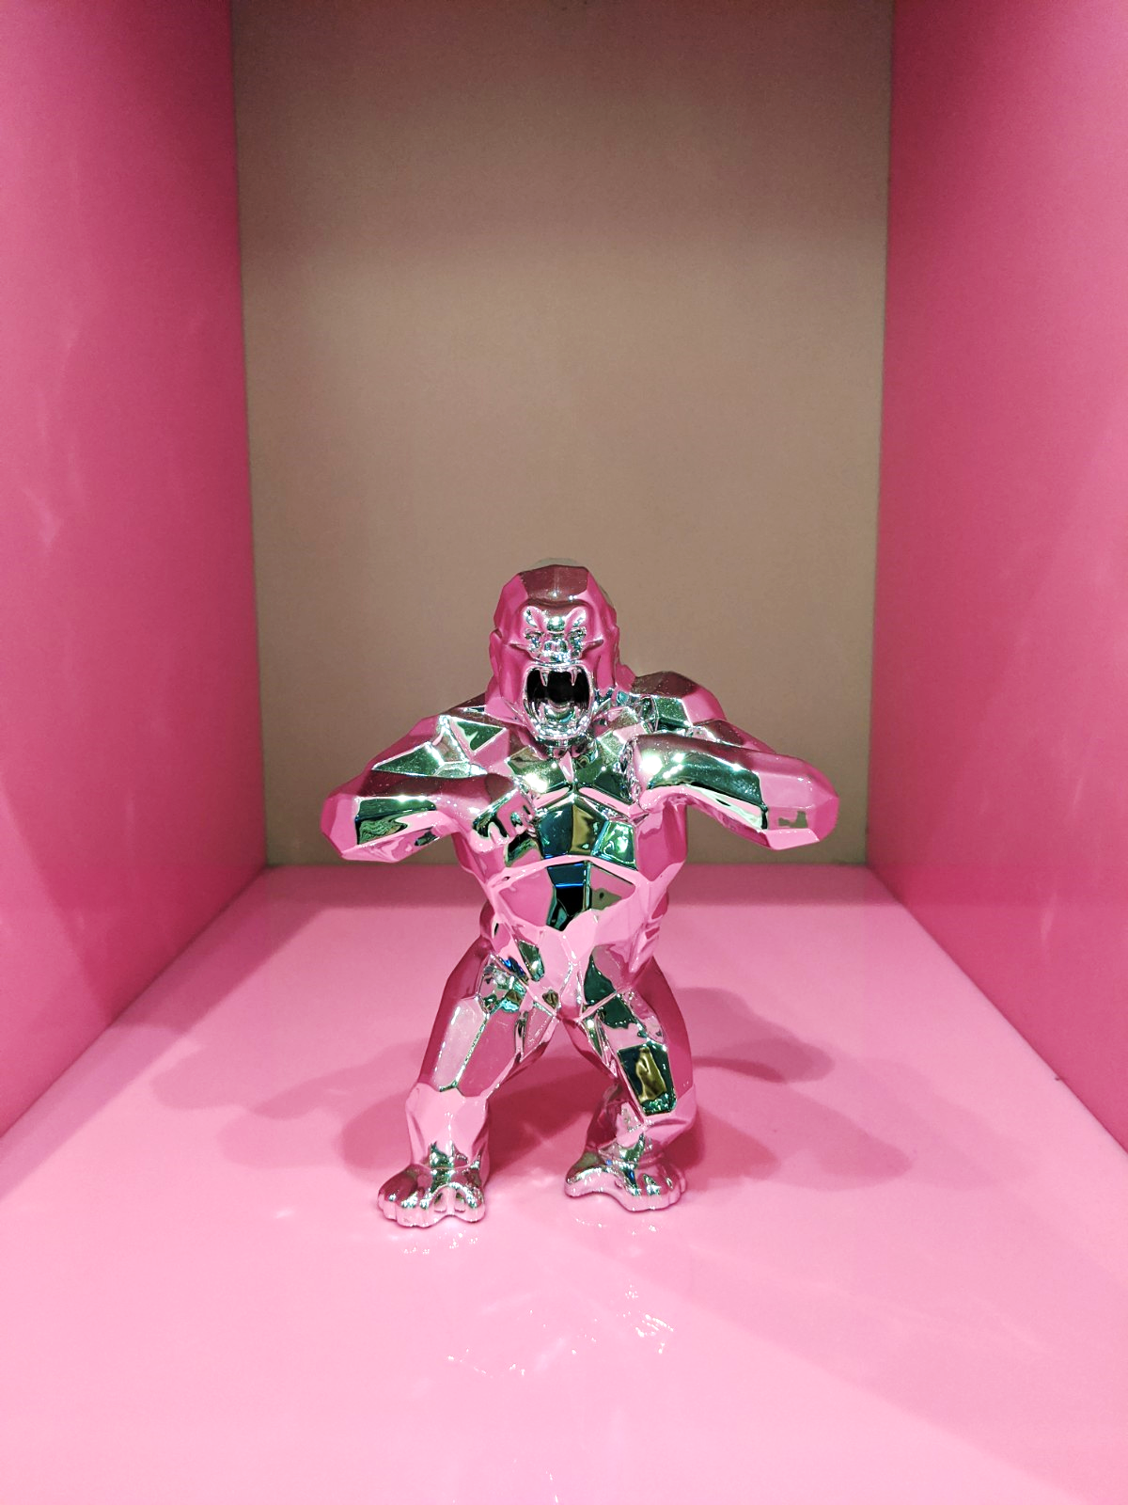
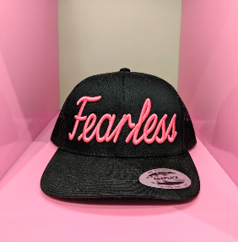
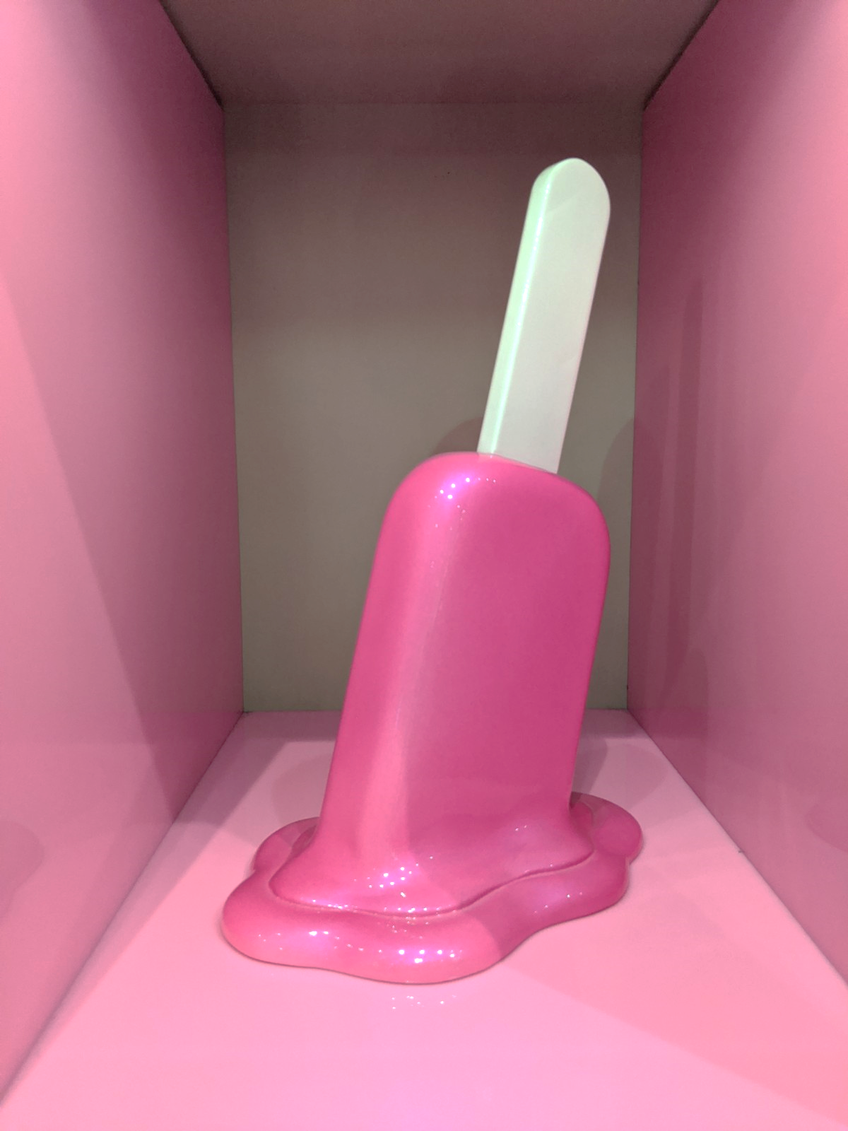
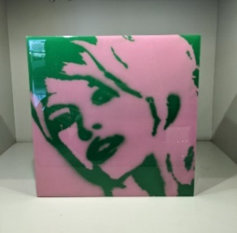
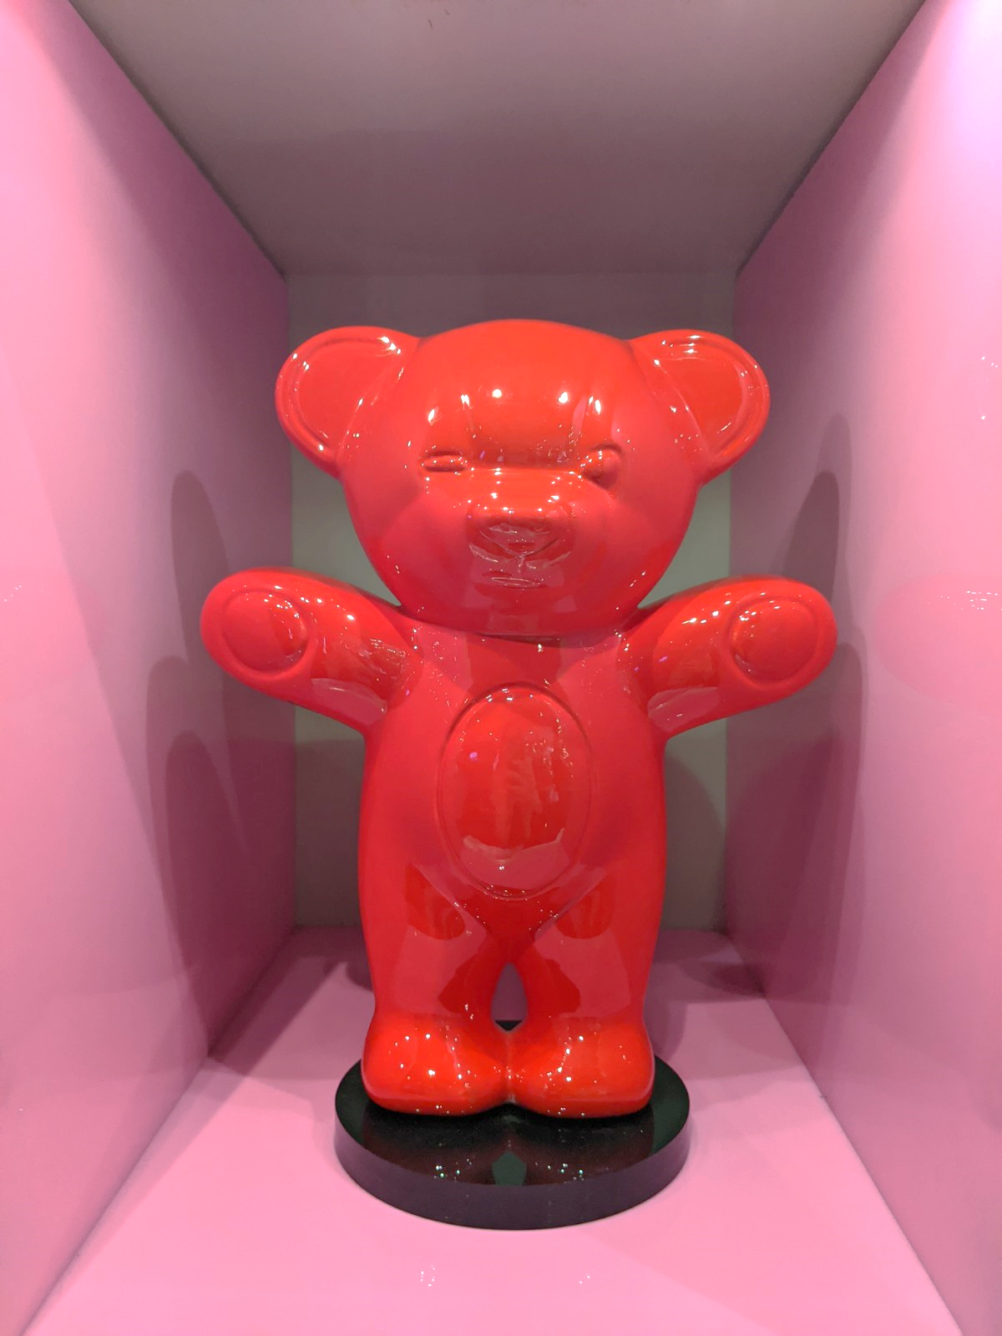
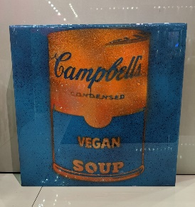
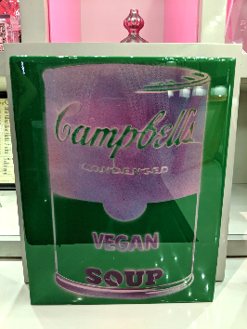
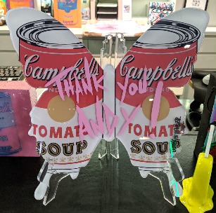
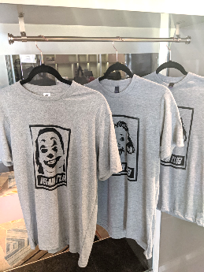
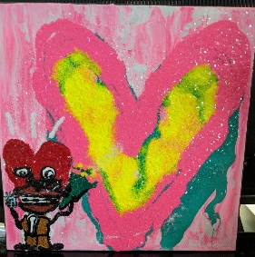
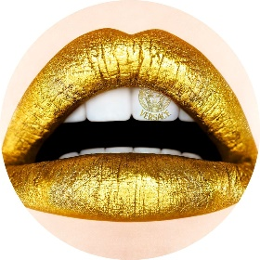
ART SHOP
KEY CHAIN
$15
MINI LOLLIPOP/POPSICLE
RESINE
EXISTS IN MULTIPLE COLORS
$99
MINI SILVER KING KONG
RESINE
$400
FEARLESS CAP
EXISTS IN MULTIPLE COLORS
$25
BIG LOLLIPOP/POPSICLE
RESINE
EXISTS IN MULTIPLE COLORS
$890
7*7 PORTRAITS
MIX MEDIA
EXISTS IN MULTIPLE COLORS
$100
TEDDY BEAR
MIX MEDIA
$1,500
MINI CAMPBELL SOUP
MIX MEDIA
EXISTS IN MULTIPLE COLORS
$100
LARGE CAMPBELL SOUP
MIX MEDIA
EXISTS IN MULTIPLE COLORS
$150
BUTTERFLY
MIX MEDIA
$350
T-SHIRTS
EXISTS IN MULTIPLE COLORS/
WITH MULTIPLE MESSAGES
$40
10 * 10 CANVAS
MIX MEDIA
EXISTS IN MULTIPLE COLORS
$150
THE COOL HEART ART SHOP AT SOFITEL LOS ANGELES
SIGNED ITEMS / CERTIFICATE OF AUTHENTICITY
CALL/TEXT +1 (310)-866-6974
TO BUY OR FOR MORE INFORMATION
WWW.THECOOLHEART.COM
TAX NOT INCLUDED

